Slide 1

Exploratory Data Analysis
G2M insight for Cab Investment firm
26 Jun 2021

Slide 2
Background – G2M(cab industry) case study
Objective: XYZ is a private firm in US. Due to remarkable growth in the Cab Industry in last few years and multiple key players in the market, it is planning for an investment in Cab industry and as per their Go-to-Market(G2M) strategy they want to understand the market before taking final decision.
Contents of this Presentation
Data Exploration and Cleaning
Analysis
Findings
Recommendations

Slide 3
Data Exploration
Final dataset
12 instances
359392
Actions Performed
Time period selected only from 31/01/2016 to 31/01/2018
Data Cleaned and Processed
No outliers or empty data in the final dataset

Slide 4
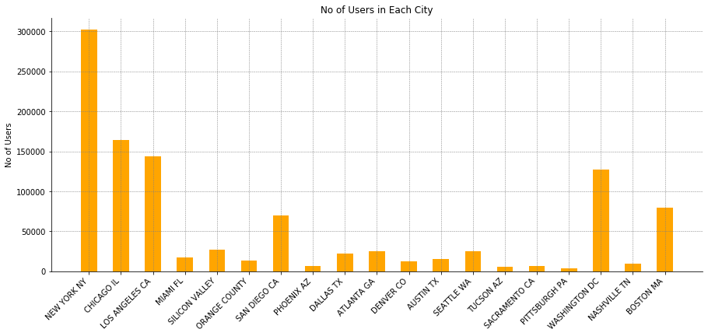
General Observations
New York appears to be the busiest city with the most number of transactions

Slide 5
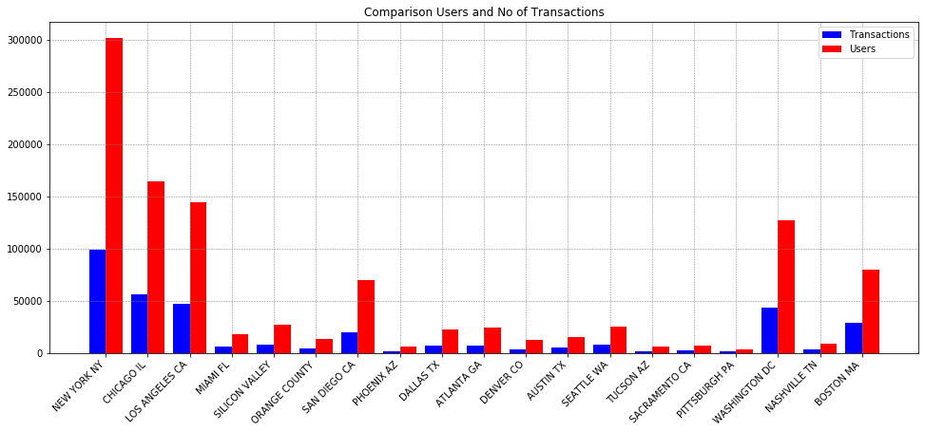
General Observations
The top 5 cities have much larger users and transactions than all the other cities

Slide 6
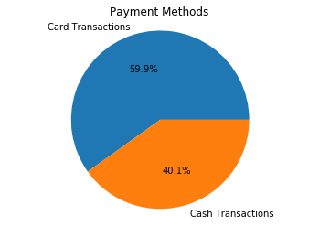
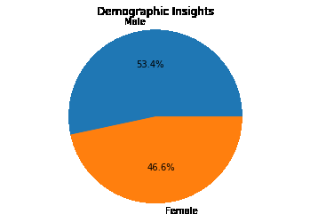
General Observations

Slide 7
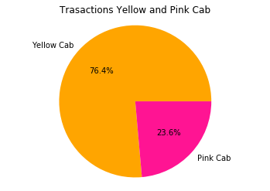
Yellow vs Pink Cab
Yellow Cab have more market share than Pink Cab

Slide 8
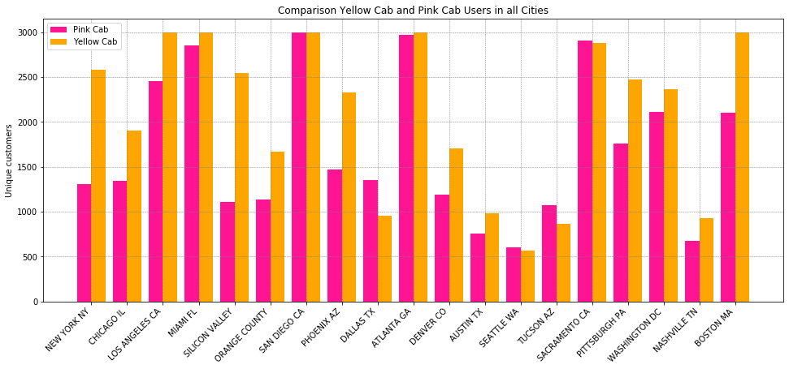
Yellow vs Pink Cab
Yellow cab has more users in most of the cities

Slide 9
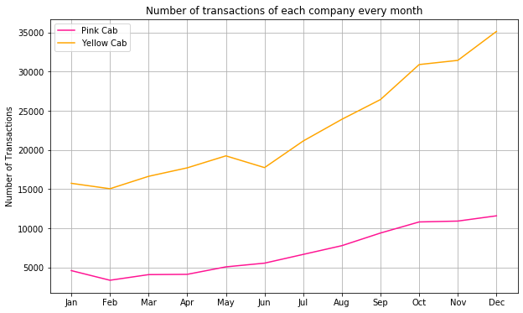
Yellow vs Pink Cab
Yellow cab has more transactions on average every month

Slide 10
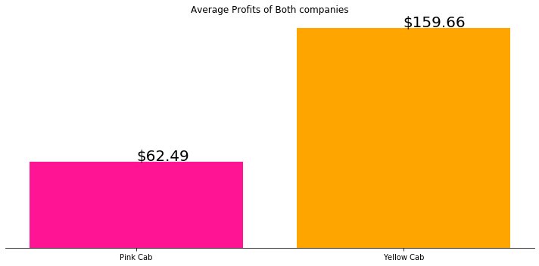
Yellow vs Pink Cab(Profits)

Slide 11
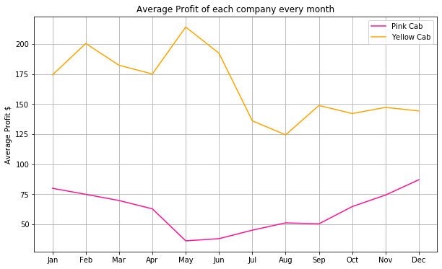
Yellow vs Pink Cab(Profits)
Yellow Cabs make most of their profit in the summer months whereas Pink cab makes most of their profit during the holiday season

Slide 12
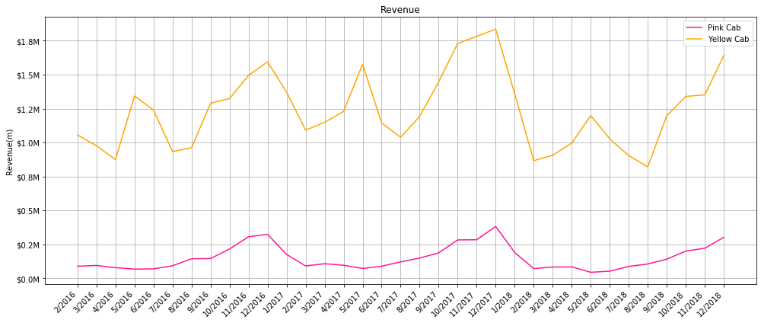
Yellow vs Pink Cab(Revenue)
Yellow Cabs generated more revenue overall and both the companies generated most revenue in January of 2018.

Slide 13
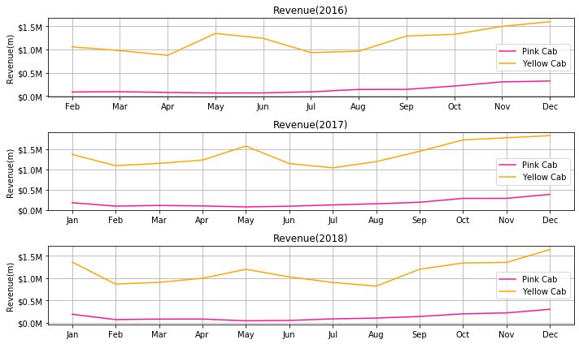
Yellow vs Pink Cab(Revenue)

Slide 14
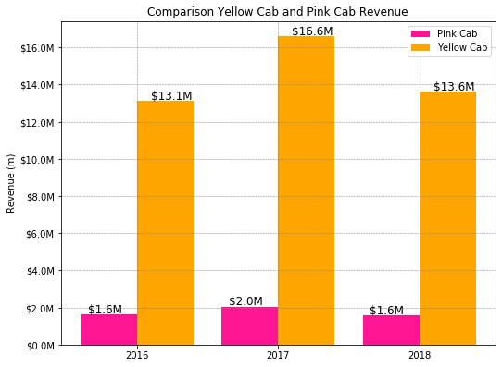
Yellow vs Pink Cab(Revenue)

Slide 15
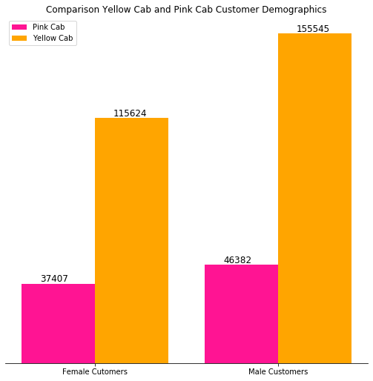
Yellow vs Pink Cab(Customer Demographics)

Slide 16
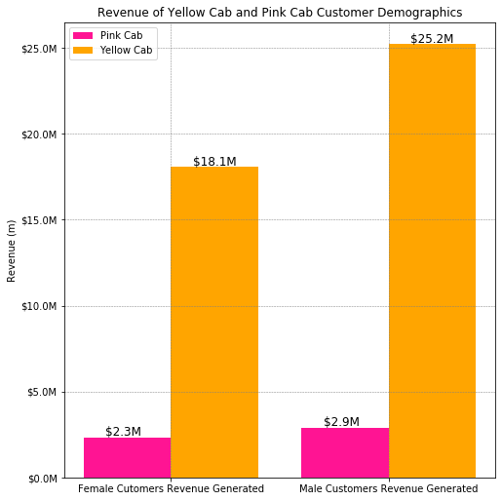
Yellow vs Pink Cab(Customer Demographics)

Slide 17
Recommendation
Yellow Cabs have more market share, profit and revenue than Pink Cabs.
By identifying the trends it is noticeable that both the companies perform similarly each year without a clear growth year to year.
Pink cabs have failed to increase their market share and revenue over the years and has remained constant similar to Yellow cabs
For these reasons it is recommended that XYZ invest in Yellow cabs as they are performing much better than Pink Cabs.
It is highly unlikely that Pink Cabs would be able to catch up to Yellow cabs according to this analysis
Finally on the basis of this analysis it is recommended that XYZ invest in Yellow cabs.

Slide 18

Thank You

